Slide 1
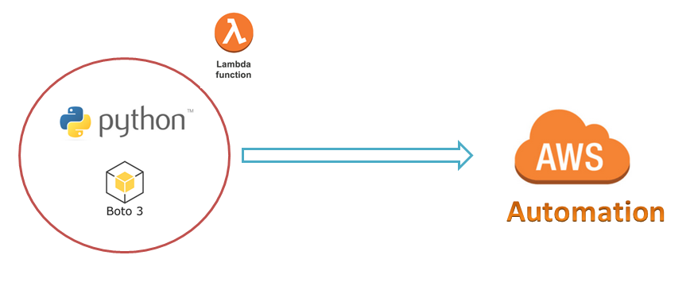
AWS Automation
with
boto3 of Python and Lambda Functions
Simple Python Boto3:
Menu Driven Script to Perform different actions on EC2 Instance
Loop control statements or commands
(break and continue)
Learn how to automate AWS common tasks using boto3 and Lambda

Slide 2
Thank you

